Slide 1



A Relational database for SETx Watershed & surface water
By
Vandan Gahdiya
Saha Sontu
Ademola Ibironke

Slide 2
OBJECTIVE
Identify data sources for SETx watershed and surface water measurements
Identify Hydrologic Unit Codes for watershed and surface water
Collect necessary data for creating database
Site Location data
Annual Peak streamflow data for SETx huc 8,10,12
Daily steamflow data for 14 counties
Daily streamflow data for other huc12 counties
Hydrology data
Develop relational database using sqlite & develop spatial maps

Slide 3
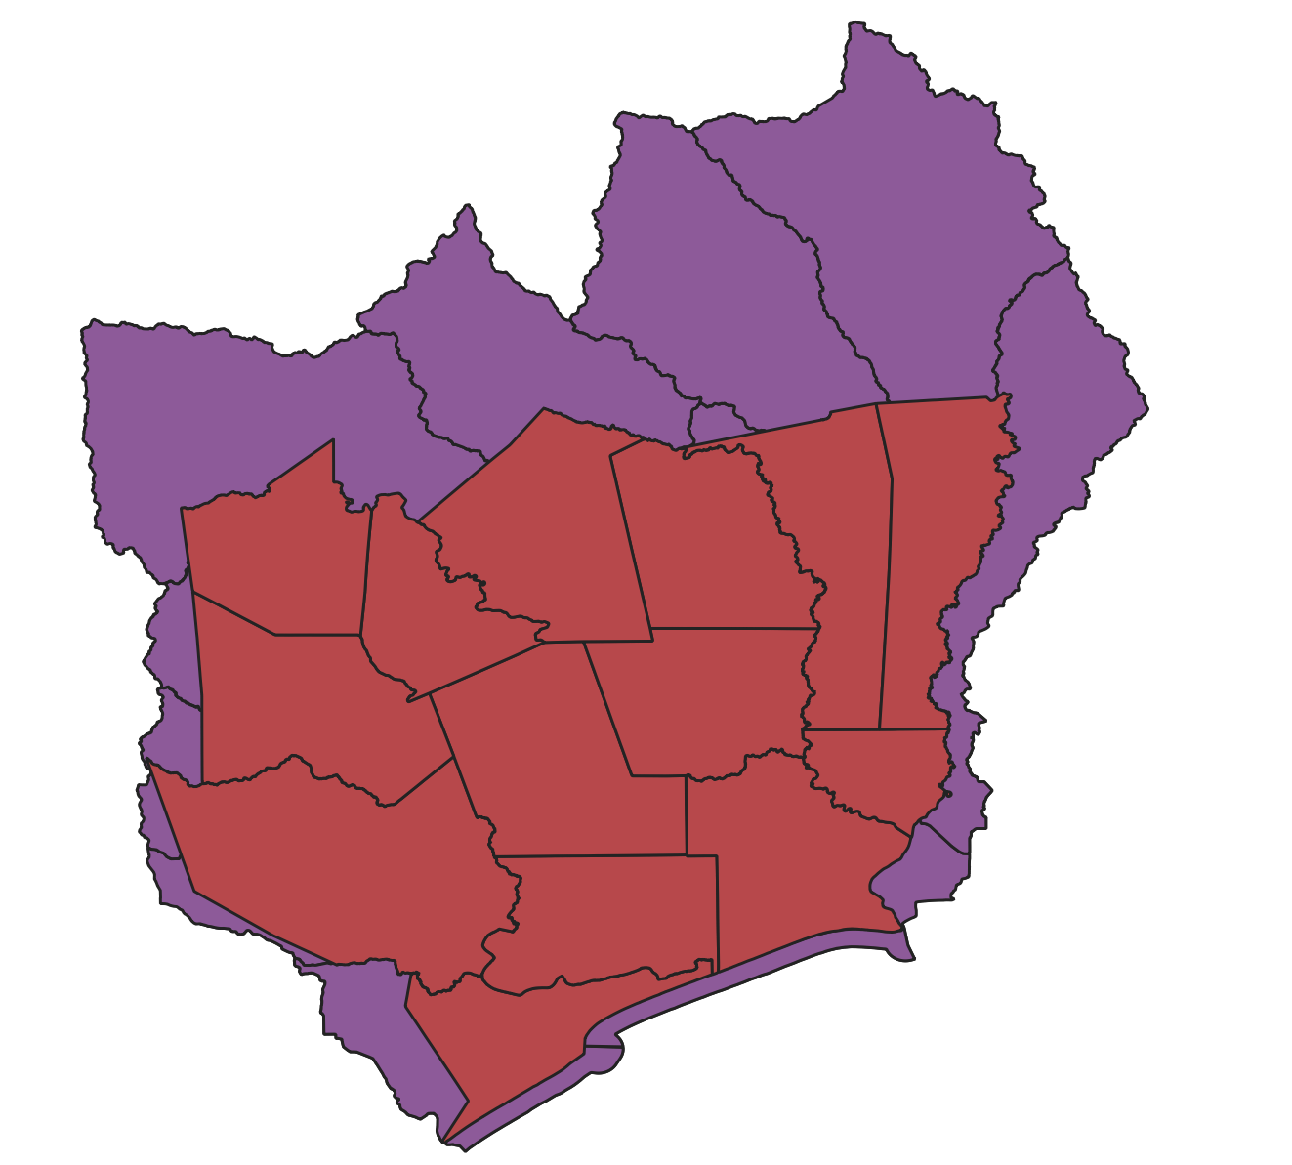
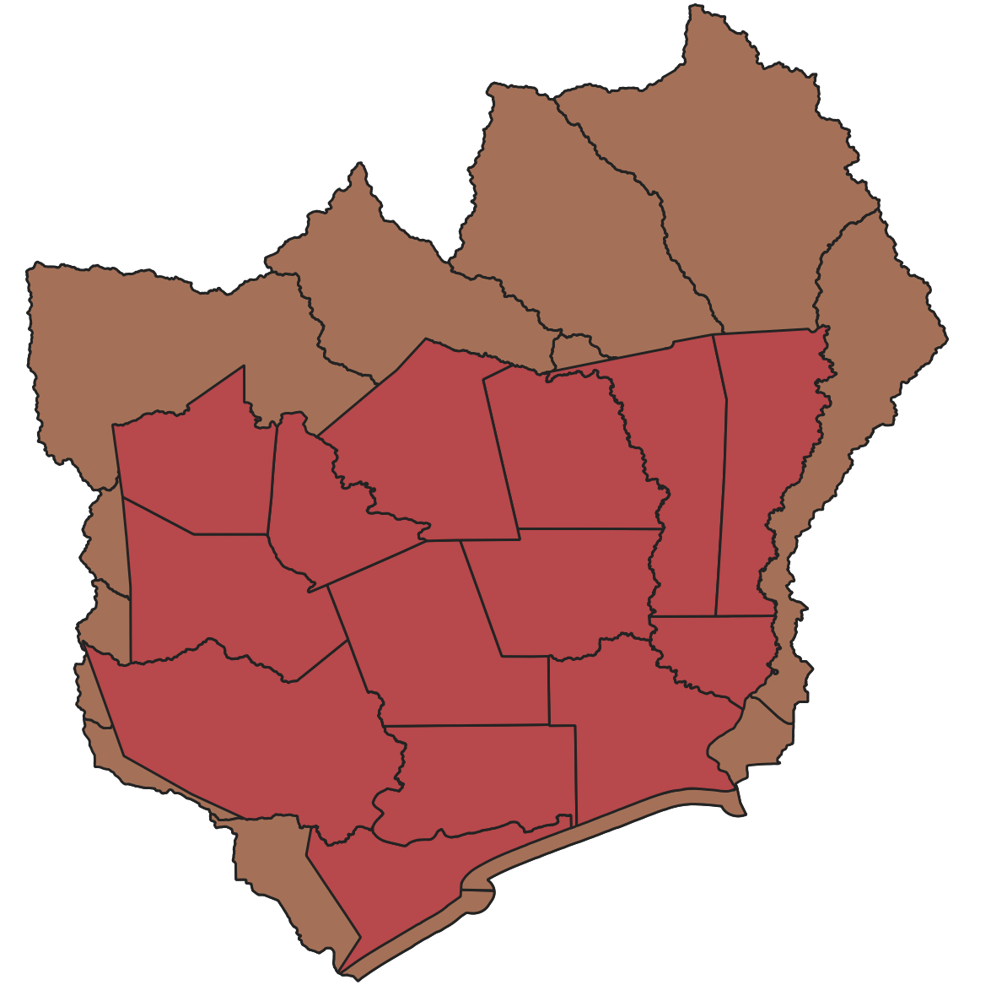
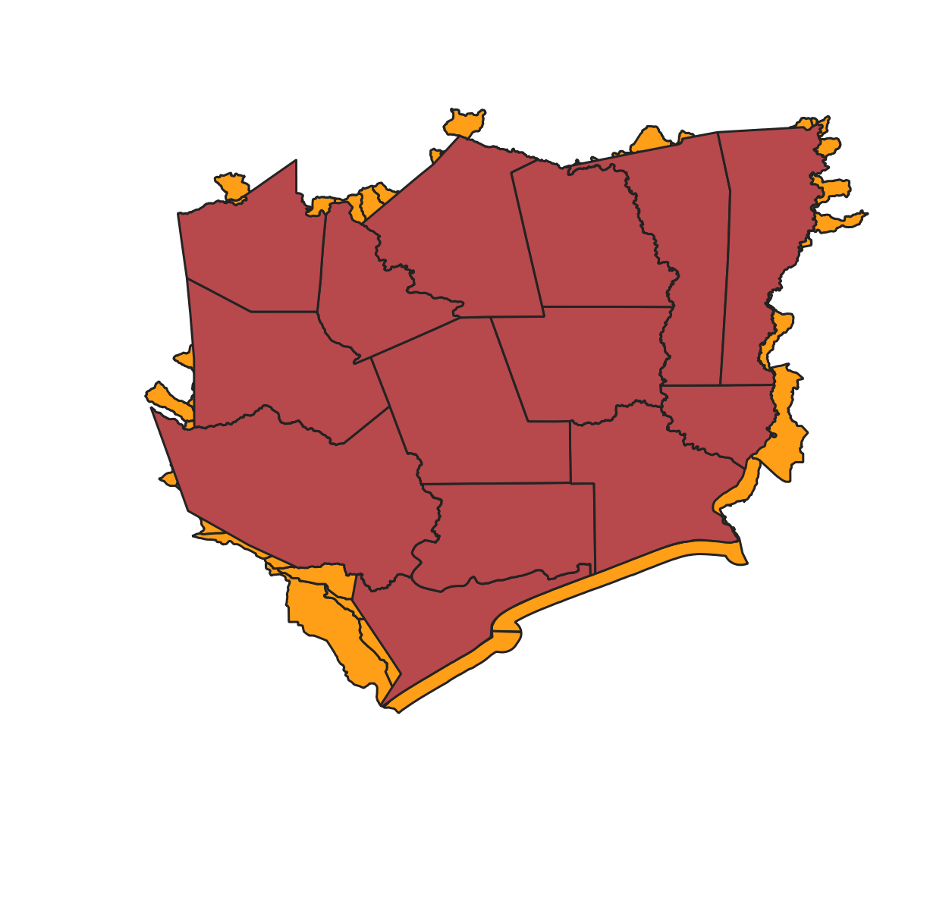
HUC 8
HUC 10
HUC 12

Slide 4
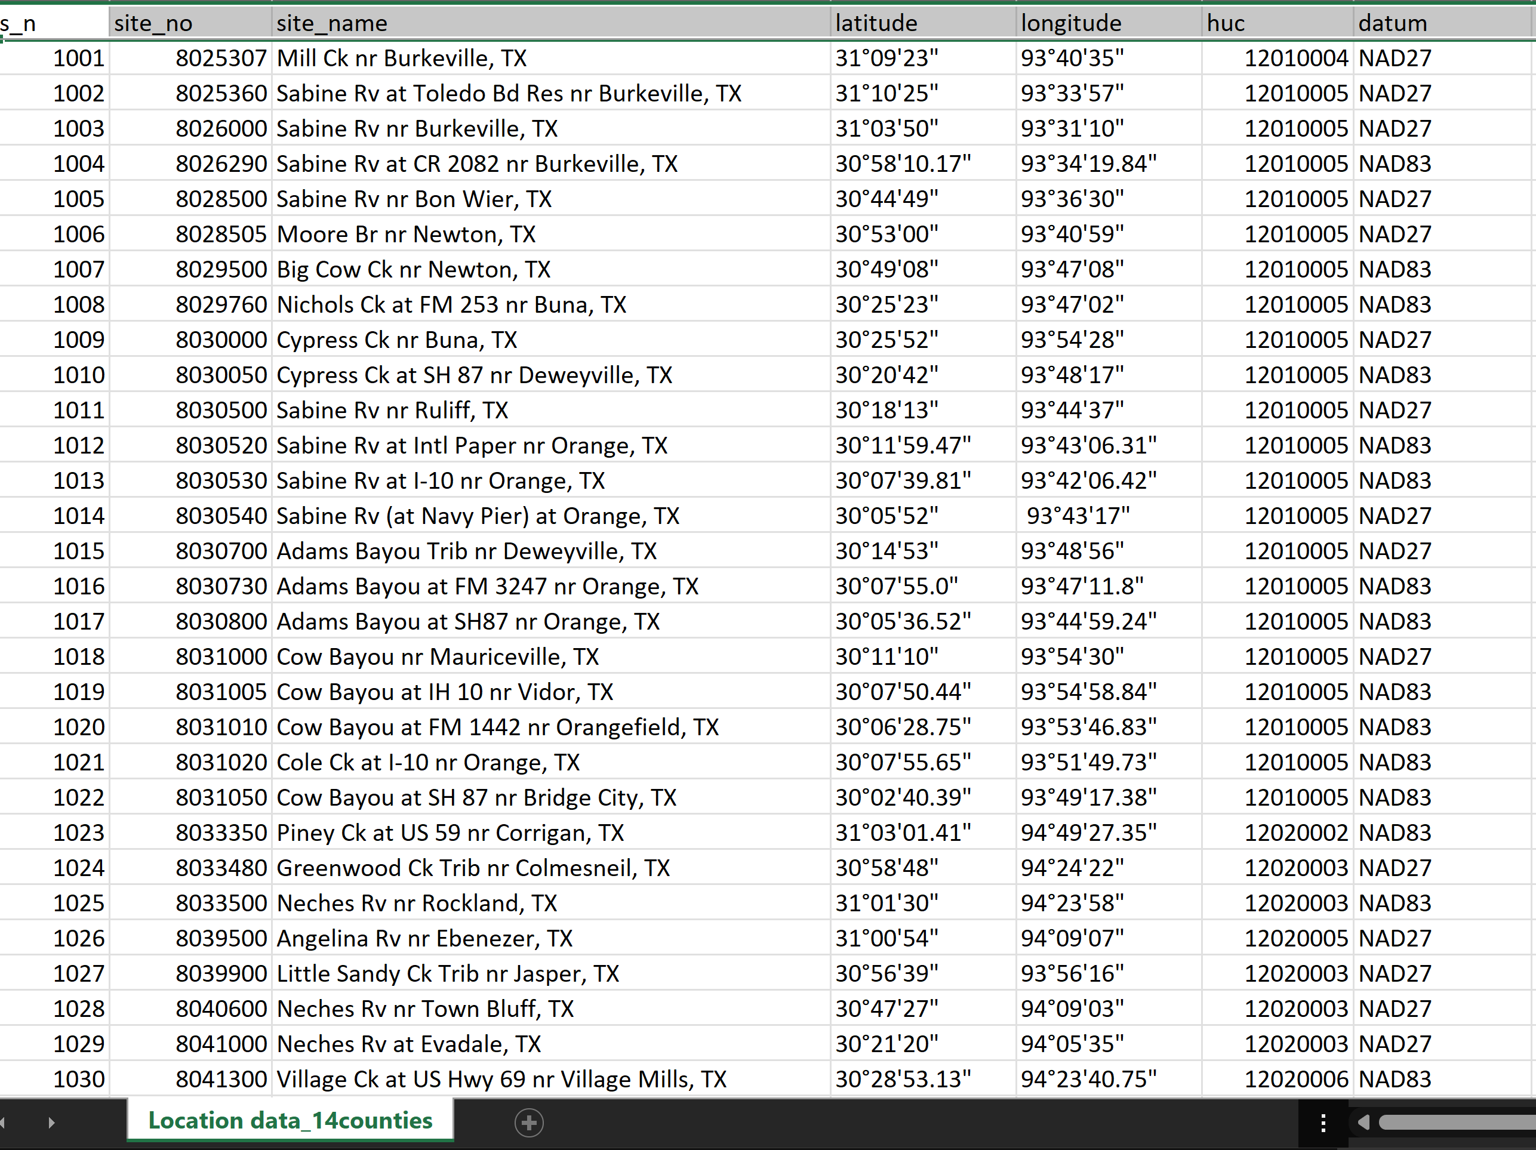
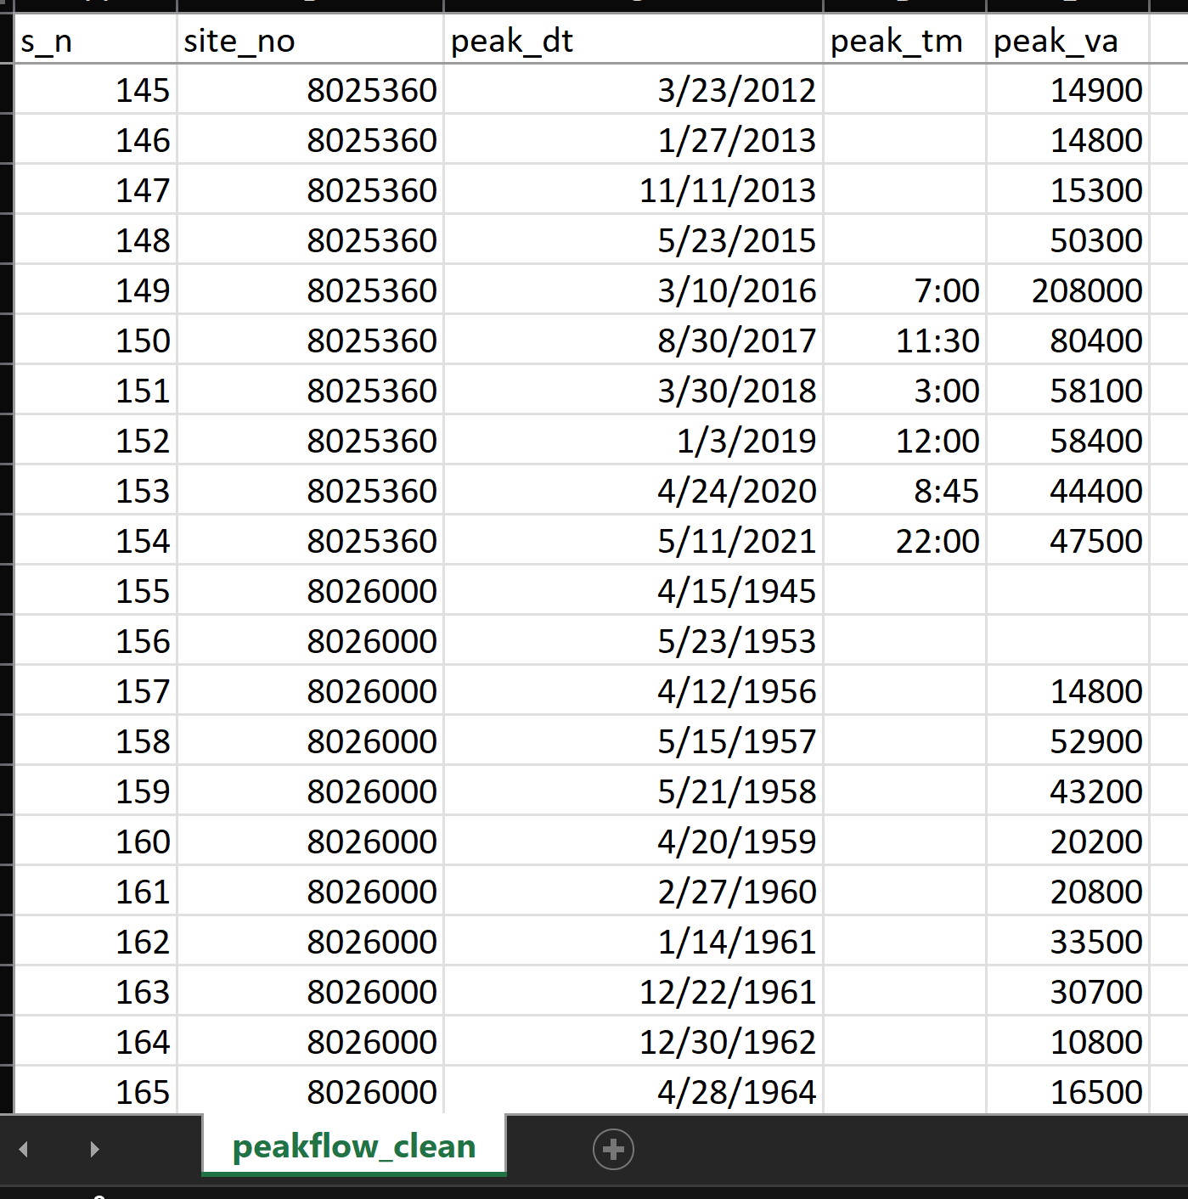
Relational DATABASE
PK- Primary Key
FK – Foreign Key
PK
FK
PK
PK

Slide 5
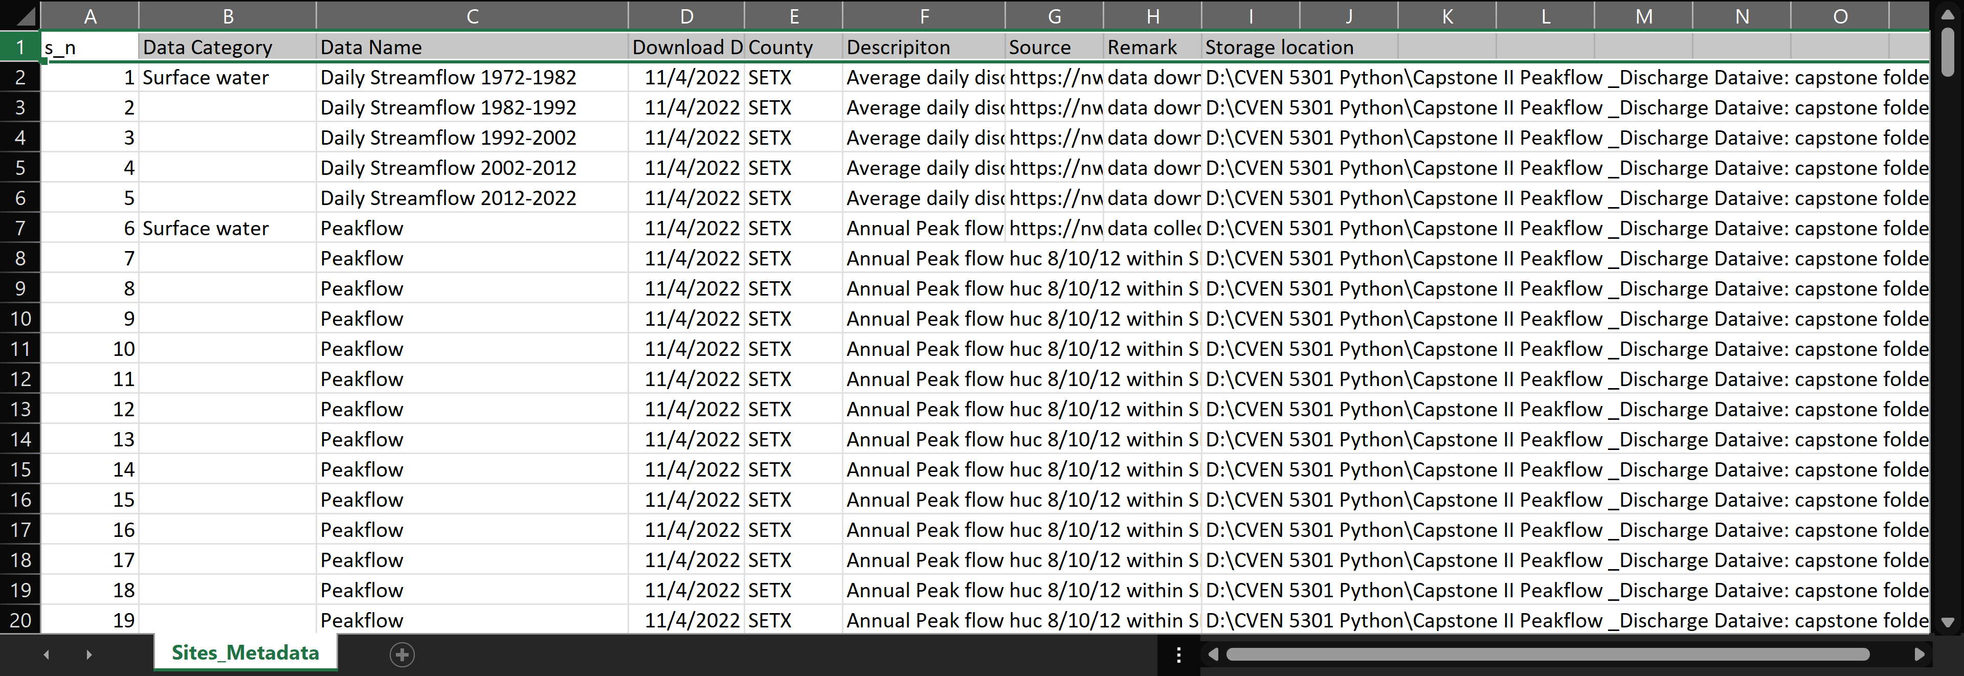
metadata

Slide 6
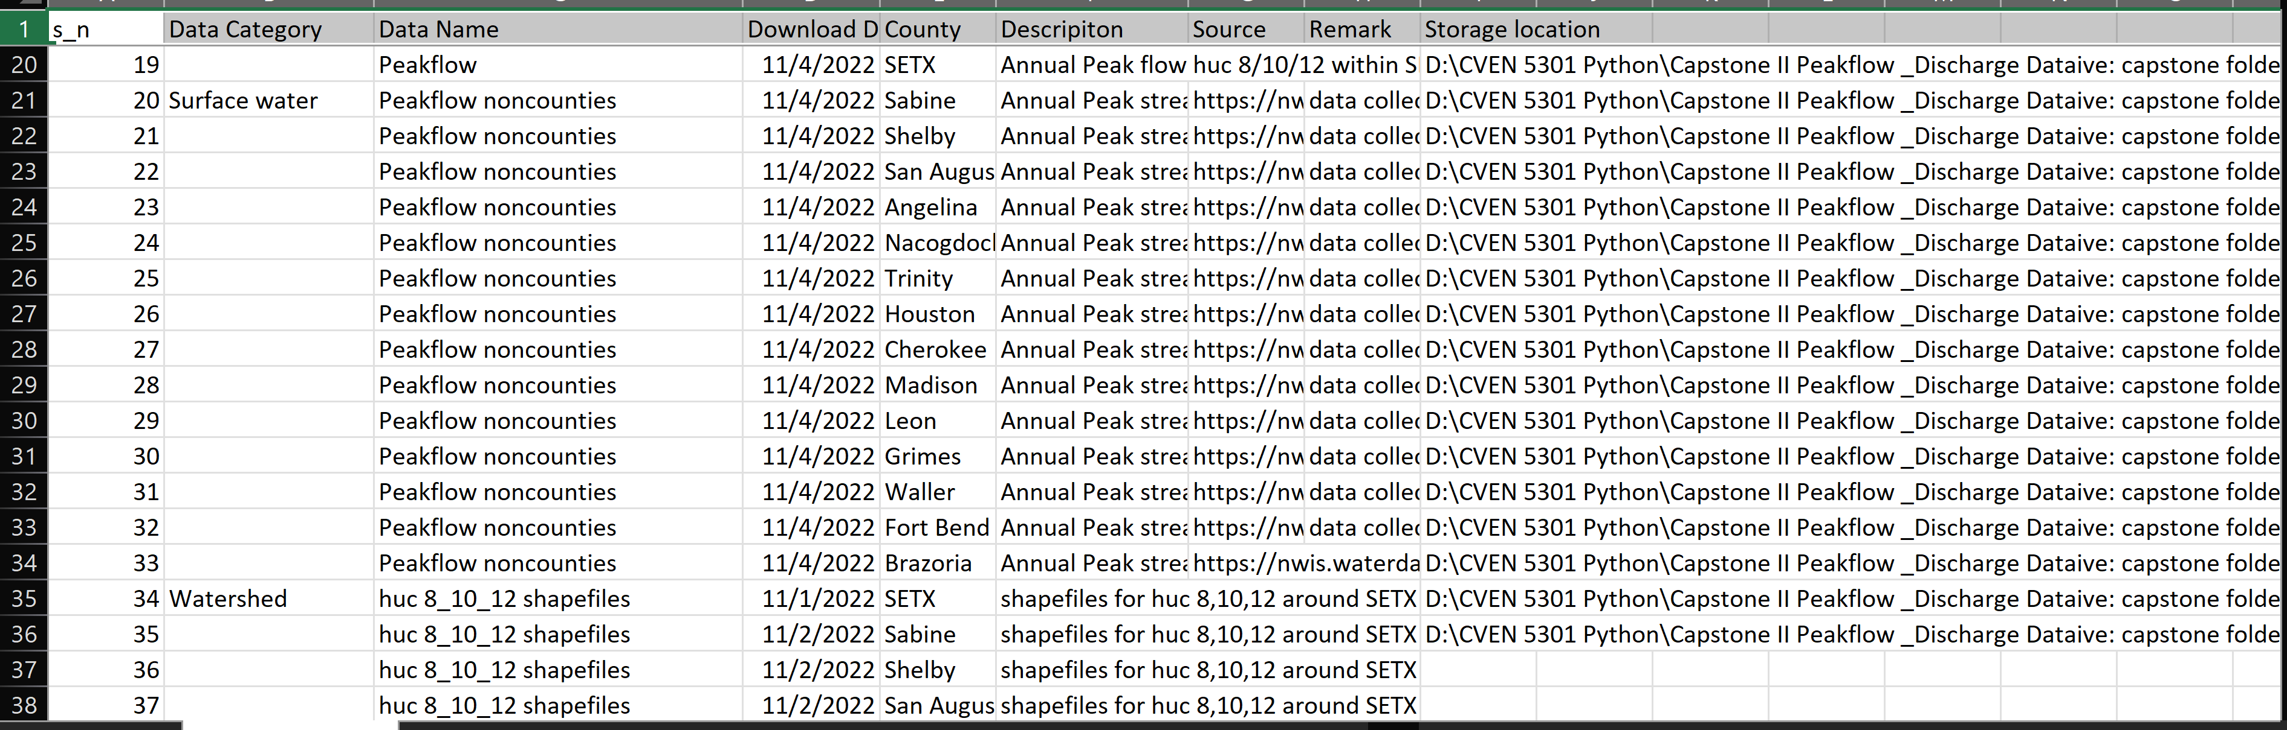
METADATA

Slide 7
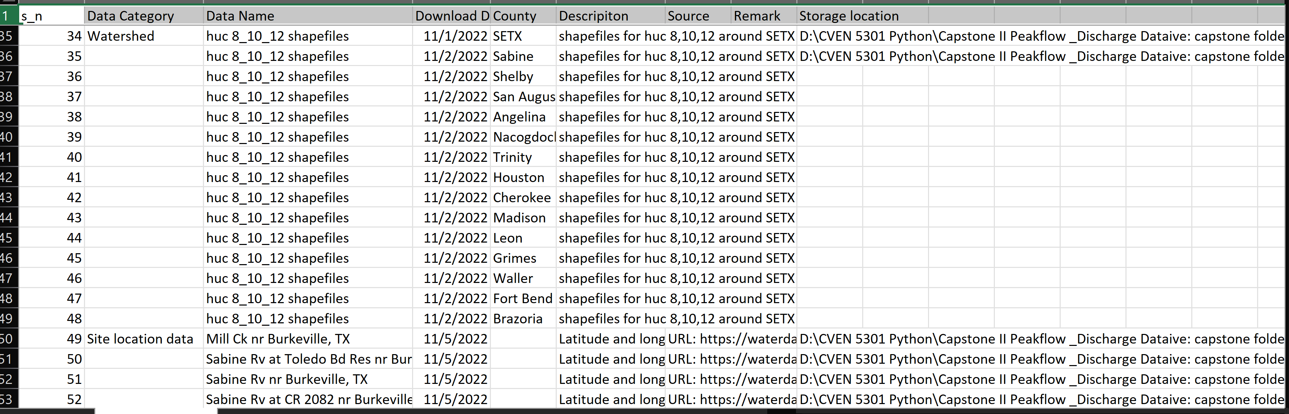
METADATA

Slide 8
Challenges
Data collection
Data handling and refining
Establishing data relationships
Code writing

Slide 9
Summary
Relational database enables faster and more efficient management and handling of data.
The bigger the data, the more useful python language and C-language libraries like sqlite become in analyzing, modeling, testing and training data.
Data visualization is useful and even necessary in data science and open-source applications like GeoPandas make working with geospatial data easier.
One of the goals of this project, to properly demonstrate creation of maps using Geopandas, was not achieved. Subsequent projects will be designed to achieve this goal.

